Slide 1


Generative AI
Full Stack Developer

Slide 2
Course C :
Developing Applications with LLM

Slide 3
03
Level-2 LLM Apps
with
Gemini + LangChain

Slide 4






Agenda
What is a level-2 LLM app
Architecture
Text apps: Recipe Generator,
Study Buddy,
History Bot (Streamlit)
Chat apps: Summarize,
Classify,
Generate names (Chainlit)
Code snippets (Gemini via langchain_google_genai)
Deployment & operational notes
Objectives:
Understand what are Text apps (Streamlit) + Chat apps (Chainlit)
And its Architecture, Code, and UI

Slide 5
What is a level-2 LLM app

Slide 6





"Level-2" LLM App?
Not a single-prompt assistant — layered system with:
Prompt engineering + Chains
Retrieval (vector DB)
Lightweight orchestration (LangChain)
UI for user interaction (Streamlit / Chainlit)
Goal:
reliable, explainable responses and small toy UI for demos

Slide 7
Architecture

Slide 8





High Level - Architecture
Data flow through system components
Streamlit
Chainlit
LanChain Orchestration
Chains
Agents
Retrievers
Vector Database
Gemini LLM
External Tools
Chroma
FAISS
Monitoring & Alerting

Slide 9
Architecture: component details
Callback Fundamentals
UI (toy): Streamlit for text utilities; Chainlit for chat.
LangChain layer: Prompt templates, Chains, Tools/Agents, Retriever/RAG.
Gemini LLM: via langchain_google_genai.ChatGoogleGenerativeAI.
Vector DB: FAISS
Ops: API keys, caching, safety settings.

Slide 10

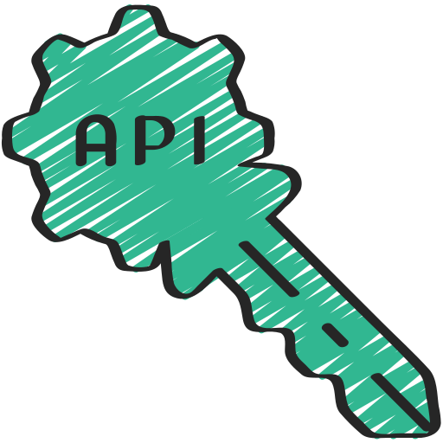

Quick setup - checklist
Install required packages:
pip install -U langchain-google-genai langchain faiss-cpu streamlit chainlit
Set API key in your environment:
Set GOOGLE_API_KEY from Google AI Studio
Additional options:
Optional: pip install sentence-transformers

Slide 11

LangChain + Gemini: minimal example
# Import the Gemini wrapper for LangChain
from langchain_google_genai import ChatGoogleGenerativeAI
# Initialize the model with parameters
llm = ChatGoogleGenerativeAI(model="gemini-2.5-flash", temperature=0.2)
# Create a simple prompt and invoke the model
resp = llm.invoke("Write a 2-line friendly recipe for omelette.")
# Output the response
print(resp)
Key points:
This minimal example shows the basic pattern for using Gemini via LangChain.
The low temperature (0.2) setting ensures more deterministic outputs, ideal for functional applications.

Slide 12
Text Apps

Slide 13




Text apps- overview
Use
Streamlit for interactive utilities
Three toy apps:
Recipe Generator:
Create customized recipes from ingredients
Study Buddy:
Generate summaries, quizzes, and flashcards
History Bot:
Answer questions with retrieval from historical sources

Slide 14

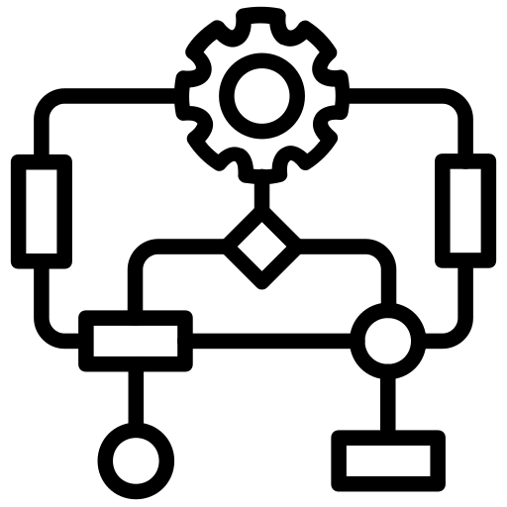
Recipe Generator (UX)
Inputs
Outputs
Ingredients (comma separated list)
Dietary preferences (vegetarian, vegan, etc.)
Maximum cooking time
Stepwise recipe instructions
Shopping list with additional ingredients
Estimated preparation & cooking time
Sample Output Preview:
Recipe: Quick Veggie Stir Fry
Time: 20 mins
Steps: 1. Heat oil... 2. Add vegetables...

Slide 15
Recipe Generator (code)
# Import required libraries
import streamlit as st
from langchain_google_genai import ChatGoogleGenerativeAI
# Create streamlit UI elements
st.title("Toy Recipe Generator")
ingredients = st.text_input("Ingredients (comma separated)")
prefs = st.selectbox("Diet", ["Any","Vegetarian","Vegan","Gluten-free"])
# Generate recipe when button is clicked
if st.button("Generate"):
llm = ChatGoogleGenerativeAI(model="gemini-2.5-flash", temperature=0.2)
prompt = f"Create a recipe using: {ingredients}. Diet: {prefs}."
out = llm.invoke(prompt)
st.markdown(out)
Key points:
This Streamlit app creates a simple recipe generator UI with input fields for ingredients and dietary preferences.
When the user clicks "Generate", it calls Gemini through LangChain with a formatted prompt and displays the response directly in the Streamlit interface.

Slide 16
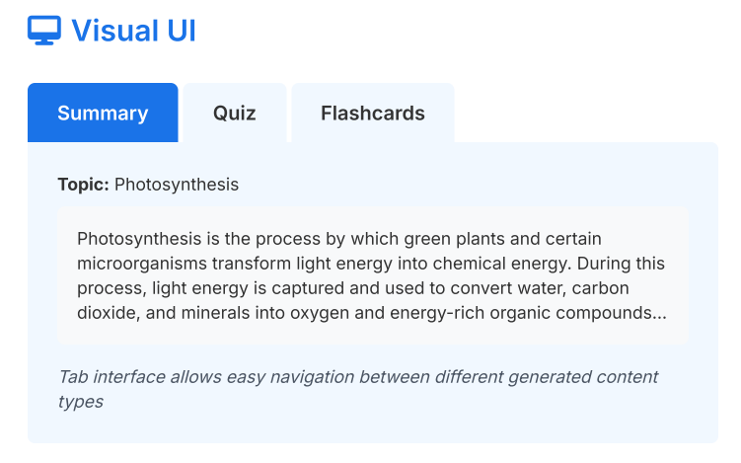

Study Buddy (UX + features)
Inputs
Topic (e.g., Photosynthesis, Machine Learning)
Difficulty (Beginner, Intermediate, Advanced)
Format (summary, quiz, flashcards)
Outputs
Features
Concise summary (150 words)
5 multiple-choice quiz questions with answers
Key concept flashcards with definitions

Slide 17
Study Buddy (code)
# Import necessary modules
from langchain_google_genai import ChatGoogleGenerativeAI
from langchain.prompts import PromptTemplate
# Initialize the Gemini model
llm = ChatGoogleGenerativeAI(model="gemini-2.5-flash")
# Create a structured prompt template
template = """You are a helpful study assistant.
Topic: {topic}
Produce:
1) A 150-word summary.
2) Five multiple-choice quiz questions with answers.
"""
prompt = PromptTemplate(template=template, input_variables=["topic"])
# Format the prompt with specific topic
in_text = prompt.format(topic="Photosynthesis")
# Generate the study materials
resp = llm.invoke(in_text)
print(resp)
Key points:
This implementation uses LangChain's PromptTemplate to create structured study materials.
The template expects a topic parameter and generates a summary and quiz questions.
This pattern allows for consistent, parameterized generation of educational content for any subject.

Slide 18


History Bot (RAG-enabled)
Ground answers in history corpus for factual accuracy and citation support
RAG Flow:
Combine Docs into
Context
Gemini Generates Answer
with Citations
User Query
Retriever
What RAG Solves:
Hallucination prevention
Historical accuracy
Source attribution
Benefits:
Verifiable answers
Clear citations to source material
Up-to-date with your history corpus

Slide 19
History Bot (code)
# Import required modules for RAG implementation
from langchain_google_genai import ChatGoogleGenerativeAI
from langchain.embeddings import GoogleGenerativeAIEmbeddings
from langchain.vectorstores import FAISS
from langchain.chains import RetrievalQA
# Create embeddings using Gemini
emb = GoogleGenerativeAIEmbeddings()
vectordb = FAISS.from_documents(docs, embedding=emb)
retriever = vectordb.as_retriever(search_kwargs={"k":3})
# Initialize Gemini and create the RAG chain
llm = ChatGoogleGenerativeAI(model="gemini-2.5-flash")
qa_chain = RetrievalQA.from_chain_type(llm=llm, chain_type="stuff", retriever=retriever)
# Run a query against the history corpus
answer = qa_chain.run("What caused the fall of the Roman Republic?")
print(answer)
RAG Pipeline:
This code demonstrates a complete RAG implementation where documents are first embedded and stored in FAISS vector database.
The retriever fetches the most relevant 3 documents for a query, which Gemini then uses as context to generate historically accurate answers with citations.

Slide 20
Chat Apps

Slide 21

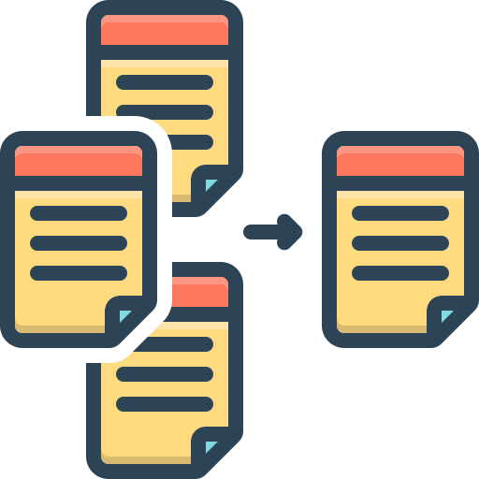
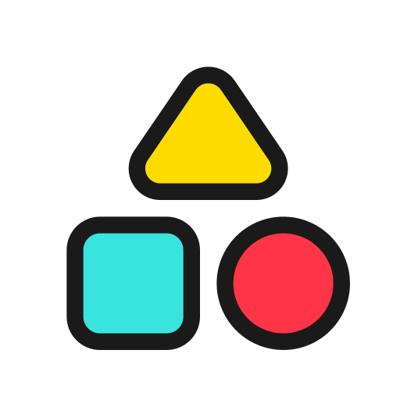

Chat apps- overview
Use
Chainlit for conversational UI
Three demos:
Summarize
Classify
Generate names
Additional features:
Supports streaming responses
Maintains conversation state

Slide 22
Chainlit - (basic chat usage)
# Import required libraries
from langchain_google_genai import ChatGoogleGenerativeAI
import chainlit as cl
# Initialize the Gemini model
llm = ChatGoogleGenerativeAI(model="gemini-2.5-flash", temperature=0.2)
# Define message handler with chainlit decorator
@cl.on_message
def main(message):
prompt = f"User asked: {message}\nProvide a short helpful response."
resp = llm.invoke(prompt)
cl.send_message(resp)
How it works:
This code creates a simple Chainlit chat interface that processes user messages with Gemini.
The @cl.on_message decorator registers the function to handle incoming messages.
Each message is formatted into a prompt, sent to the Gemini model, and the response is displayed back to the user in the chat interface.

Slide 23
Summarize / Classify / Generate names
Summarize
long text → 3-line TL;DR + bullet points
Classify
text → structured label (category, tone, intent)
Generate names
product brief → 20 creative names + rationale

Slide 24
Code snippets

Slide 25
Project code walkthrough

Slide 26
Deployment & operational notes

Slide 27
Safety, rate limits, best practices
Store API keys securely (environment variables)
Temperature: 0.1-0.3
Deterministic responses
Temperature: 0.7-1.0
Creative responses
Use parameter controls for consistent outputs:
max_tokens
Limit output length
n
Generate multiple completions
safety_settings
Filter harmful content

Slide 28
Deployment & monitoring
Local Development
Production Deployment
Containerize applications (Docker)
Add API gateway for traffic management
Secure API keys (environment variables)
Implement comprehensive logging
Run your apps locally with simple commands
streamlit run app.py
chainlit run app.py
RAG Maintenance
Re-embed documents periodically to keep knowledge base current

Slide 29
Q/A

Slide 30
Thanks

